Slide 1
SQL Server
T-SQL
INSERT/INSERT INTO/UPDATE/DELETE
In all slides, db=database

Slide 2
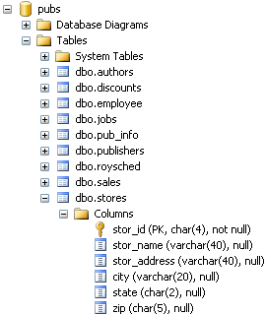

INSERT
INSERT tells SQL Server what it is that we are going to be doing in the statement.
To do an insert that assumes a value will be provided for every column:
INSERT INTO Stores VALUES('TEST','Test Store','1234 My Street','Canton','OH','44720')

Slide 3
INSERT cont.
Try to run the same exact query again:
Because we are inserting values into every column, we are attempting to duplicate StoreID – which is the primary key and must be unique.
INSERT INTO Stores VALUES('TEST','Test Store','1234 My Street','Canton','OH','44720')

Slide 4

Seeing our results
SELECT * FROM Stores WHERE stor_id='TEST'

Slide 5

Inserting into specific columns
Notice that we are leaving out the address column – this column is not required and allows for nulls.
INSERT INTO stores(stor_id,stor_name,city,state,zip)VALUES('TST2','Test Store','Canton','OH','44720')

Slide 6
Inserting into specific columns cont.
If a column is not nullable and there is nothing to insert, then one of the following must be true:
  The column has a default value
  The column has a system generated value (think auto increment)

Slide 7
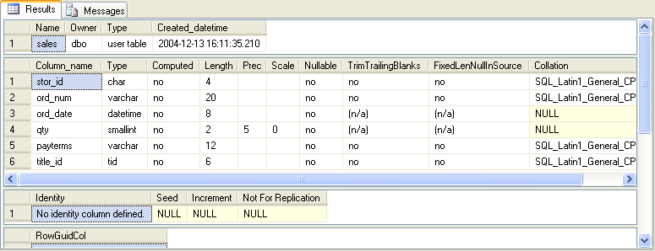
Viewing table information
Other than looking at a table in the properties dialog, we can use a system stored procedure:
EXEC sp_help sales

Slide 8

More on Insert
Make sure to format the types as you’re inserting them into the database – no quotes for numeric values, quotes otherwise:
INSERT INTO sales(stor_id,ord_num,ord_date,qty,payterms,title_id)VALUES('TEST','TESTORDER','08/22/2007',10,'NET 30','BU1032')

Slide 9
INSERT INTO
Often we may have a block of data that we want inserted.
  From one table to another
  From one database to another

Slide 10
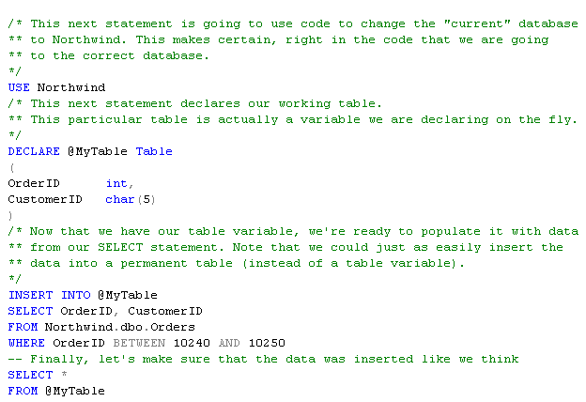
INSERT INTO cont.

Slide 11

UPDATE Statement
Update Statement:
UPDATE stores
SET city = 'There'
WHERE stor_id = 'TEST'

Slide 12

Seeing the result
The value has changed:
SELECT *
FROM stores
WHERE stor_id = 'TEST'

Slide 13

Updating more than one column
UPDATE stores
SET city = 'There', state = 'CA'
WHERE stor_id = 'TEST'

Slide 14
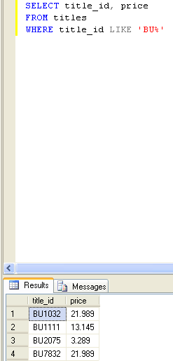
Update & Like
UPDATE titles
SET price = price * 1.1
WHERE title_id LIKE 'BU%'

Slide 15

Advanced Updates
We can perform mathematical operations before the UPDATE is actually written to each record:
UPDATE titles
SET price = price / 1.1
WHERE title_id LIKE 'BU%‘
UPDATE titles
SET price = ROUND(price * 1.1, 2)
WHERE title_id LIKE 'BU%'

Slide 16
DELETE
Includes a table name and most often a WHERE clause.
First check to see if data exists:
Now lets delete that row:
SELECT *
FROM stores
WHERE stor_id = 'TEST'
DELETE stores
WHERE stor_id = 'TEST'

Slide 17
Delete cont.
SQL Server won’t let us delete a row if it is referenced in another table (foreign key).
The other row must be deleted first:
DELETE sales
WHERE stor_id = 'TEST'
DELETE stores
WHERE stor_id = 'TEST'

